Slide 1
Operating System
Nahidul Islam Lecturer, Dept. o CSE
Dhaka City College

Slide 2
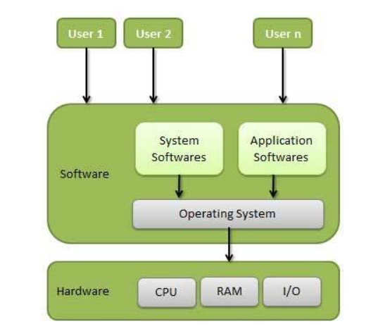
Overview
An Operating System (OS) is an interface between a computer user and computer hardware. An operating system is a software which performs all the basic tasks like file management, memory management, process management, handling input and output, and controlling peripheral devices such as disk drives and printers.
An operating system is software that enables applications to interact with a computer's hardware. The software that contains the core components of the operating system is called the kernel.
The primary purposes of an Operating System are to enable applications (softwires) to interact with a computer's hardware and to manage a system's hardware and software resources.
Some popular Operating Systems include Linux Operating System, Windows Operating System, VMS, OS/400, AIX, z/OS, etc.

Slide 3
Major Functions of OS
Process Management
Handles creation, scheduling, and termination of processes.
Manages process synchronization and communication.
Memory Management
Allocates and deallocates memory space as needed by programs.
Manages virtual memory and paging.
File System Management
Organizes, stores, retrieves, and manages data in files.
Provides access control and file system hierarchy.
Device Management
Controls and manages input/output devices.
Provides drivers and interfaces for hardware interaction.

Slide 4
Continue…
Security and Access Control
Protects data and resources from unauthorized access.
Implements authentication and encryption.
User Interface
Provides a command-line interface (CLI) or graphical user interface (GUI) for user interaction.
Networking
Manages network connections and communication protocols.
Supports data transfer and resource sharing over networks.
Error Detection and Handling
Detects and responds to hardware and software errors.
Ensures system stability and reliability.
Resource Allocation
Manages and allocates resources like CPU, memory, and storage efficiently among users and applications.

Slide 5
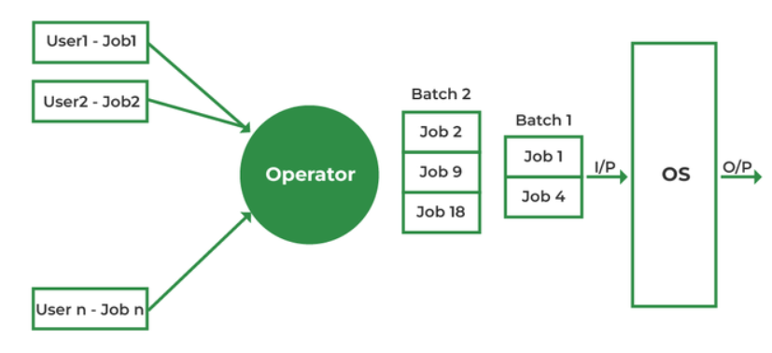
Batch Operating System
The users of a batch operating system do not interact with the computer directly. Each user prepares his job on an off-line device like punch cards and submits it to the computer operator. To speed up processing, jobs with similar needs are batched together and run as a group. The programmers leave their programs with the operator and the operator then sorts the programs with similar requirements into batches.
The problems with Batch Systems are as follows −
Lack of interaction between the user and the job.
CPU is often idle, because the speed of the mechanical I/O devices is slower than the CPU.
Difficult to provide the desired priority.

Slide 6
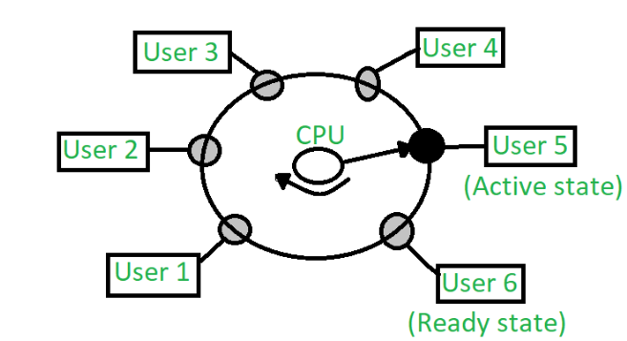
Time Sharing OS
Time-sharing is a technique which enables many people, located at various terminals, to use a particular computer system at the same time. Time-sharing or multitasking is a logical extension of multiprogramming. Processor's time which is shared among multiple users simultaneously is termed as time-sharing.
Multiple jobs are executed by the CPU by switching between them, but the switches occur so frequently. Thus, the user can receive an immediate response. For example, in a transaction processing, the processor executes each user program in a short burst or quantum of computation. That is, if n users are present, then each user can get a time quantum. When the user submits the command, the response time is in few seconds at most. The operating system uses CPU scheduling and multiprogramming to provide each user with a small portion of a time.
Advantages
Each task gets an equal opportunity.
Fewer chances of duplication of software.
CPU idle time can be reduced.
Disadvantages
Reliability problem.
One must have to take of the security and integrity of user programs and data.
Data communication problem.

Slide 7
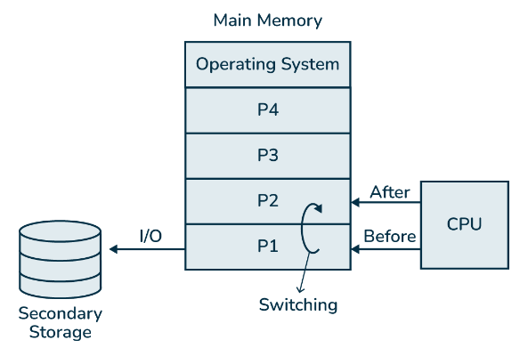
Multiprogramming OS
In multiprogramming system, multiple programs are to be stored in memory and each program has to be given a specific portion of memory which is known as process. The operating system handles all these process and their states. Before the process undergoes execution, the operating system selects a ready process by checking which one process should undergoes execution. When the chosen process undergoes CPU execution, it might be possible that in between process need any input/output operation at that time process goes out of main memory for I/O operation and temporarily stored in secondary storage and CPU switches to next ready process. And when the process which undergoes for I/O operation comes again after completing the work, then CPU switches to this process. This switching is happening so fast and repeatedly that creates an illusion of simultaneous execution.
Advantages of Multiprogramming
Increase the resource utilization of a computer system.
Support multiple simultaneously interactive users (terminals).
Keeps multiple runnable jobs loaded in memory .
The waiting time for a program is reduced.
Improve system’s overall responsiveness.
Improve the reliability and stability of the system.

Slide 8
Real Time Operating System(RTOS)
A real-time system is defined as a data processing system in which the time interval required to process and respond to inputs is so small that it controls the environment. The time taken by the system to respond to an input and display of required updated information is termed as the response time. So in this method, the response time is very less as compared to online processing.
Real-time systems are used when there are rigid time requirements on the operation of a processor or the flow of data and real-time systems can be used as a control device in a dedicated application. A real-time operating system must have well-defined, fixed time constraints, otherwise the system will fail. For example, Scientific experiments, medical imaging systems, industrial control systems, weapon systems, robots, air traffic control systems, etc.
Hard real-time systems:
Hard real-time systems guarantee that critical tasks complete on time. In hard real-time systems, secondary storage is limited or missing and the data is stored in ROM. In these systems, virtual memory is almost never found.
Soft real-time systems
Soft real-time systems are less restrictive. A critical real-time task gets priority over other tasks and retains the priority until it completes. Soft real-time systems have limited utility than hard real-time systems. For example, multimedia, virtual reality, Advanced Scientific Projects like undersea exploration and planetary rovers, etc.

Slide 9
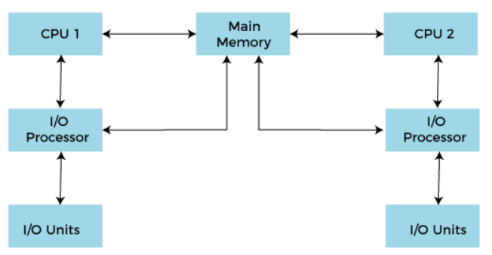
Multiprocessing
In operating systems, to improve the performance of more than one CPU can be used within one computer system called Multiprocessor operating system.
Multiple CPUs are interconnected so that a job can be divided among them for faster execution. When a job finishes, results from all CPUs are collected and compiled to give the final output. Jobs needed to share main memory and they may also share other system resources among themselves. Multiple CPUs can also be used to run multiple jobs simultaneously.
For Example: UNIX Operating system is one of the most widely used multiprocessing systems.
Advantages:
Increased Throughput: More tasks are completed in a given time.
Improved Responsiveness: Systems can handle more processes without delay.
Enhanced Performance for Multithreaded Applications: Applications designed to run multiple threads perform better.

Slide 10
Network Operating System
A Network Operating System runs on a server and provides the server the capability to manage data, users, groups, security, applications, and other networking functions. The primary purpose of the network operating system is to allow shared file and printer access among multiple computers in a network, typically a local area network (LAN), a private network or to other networks.
Examples of network operating systems include Microsoft Windows Server 2003, Microsoft Windows Server 2008, UNIX, Linux, Mac OS X, Novell NetWare, and BSD.
Functions of the NOS (Network Operating System)
The following are the main functions of NOS:
Creating and managing user accounts on the network.
Controlling access to resources on the network.
Provide communication services between the devices on the network.
Monitor and troubleshoot the network.
Configuring and Managing the resources on the network

Slide 11
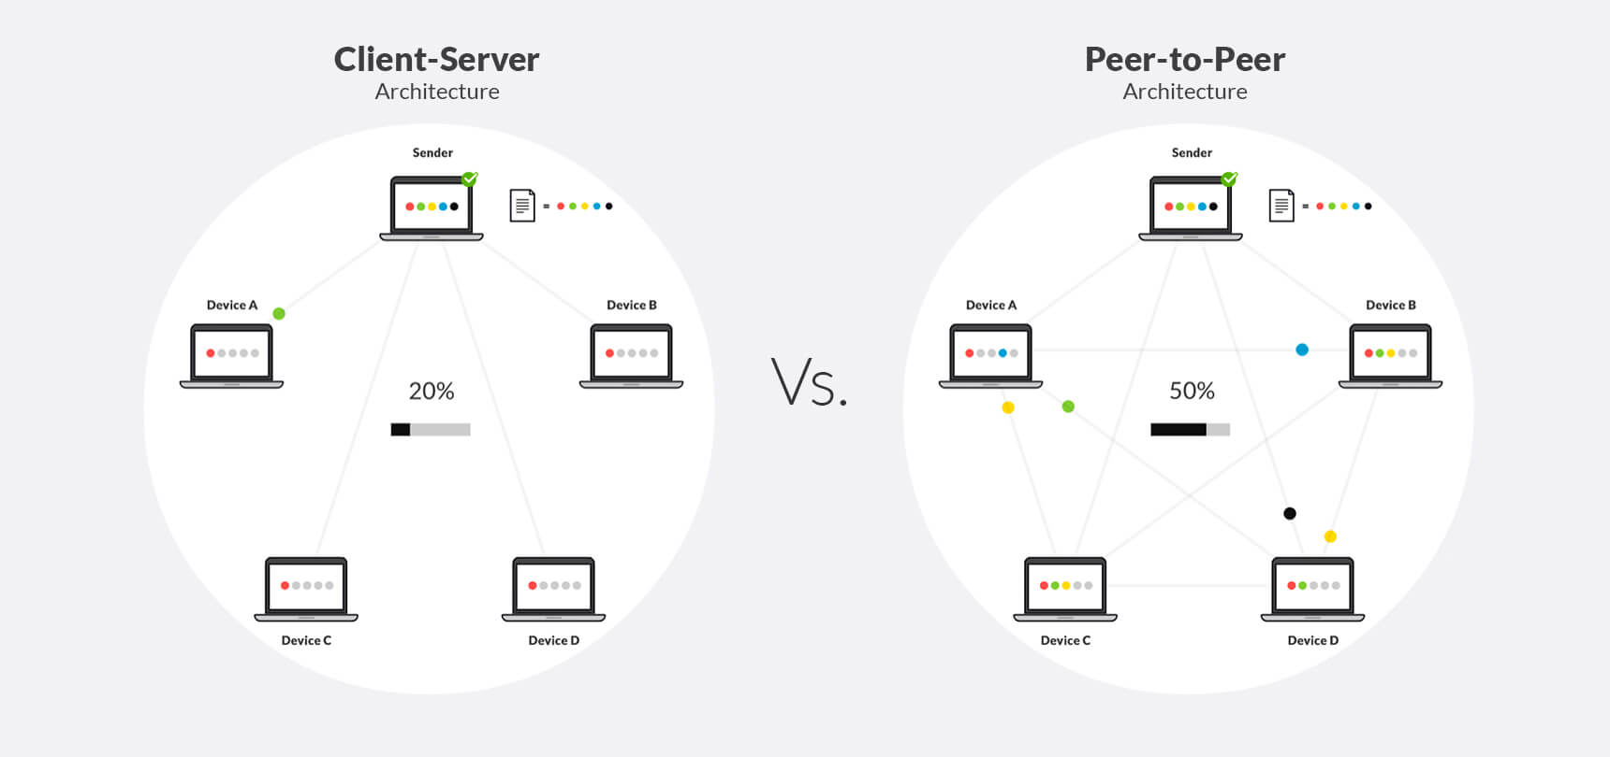
Types of Network Operating System
Peer to Peer: Peer-to-peer network operating systems allow the sharing of resources and files with small-sized networks and having fewer resources. In general, peer-to-peer network operating systems are used on LAN.
Client/server: Client-server network operating systems provide users access to resources through the central server. This NOS is too expensive to implement and maintain. This operating system is good for the big networks which provide many services.

Slide 12
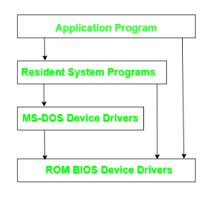
Disk Operating System(DOS)
MS-DOS Operating System also called the Disk Operating system was Developed by Microsoft for x86 personal computers. It works on the phenomenon of doing less and getting more. It is a 16-bit operating system. A closed-source model was initially released on August 12, 1981, and the final release on September 14, 2000.
Features of MS-DOS Operating System
It is a minimalist OS which means it can boot a computer and run programs.
Still usable for simple tasks like word processing and playing games.
The mouse cannot be used to give inputs instead it uses basic system commands to perform the task.
It is a 16-bit, free operating system.
It is a single-user operating system.
It is very lightweight due to fewer features available and no multitasking.

Slide 13
Windows Operating System

